Slide 1
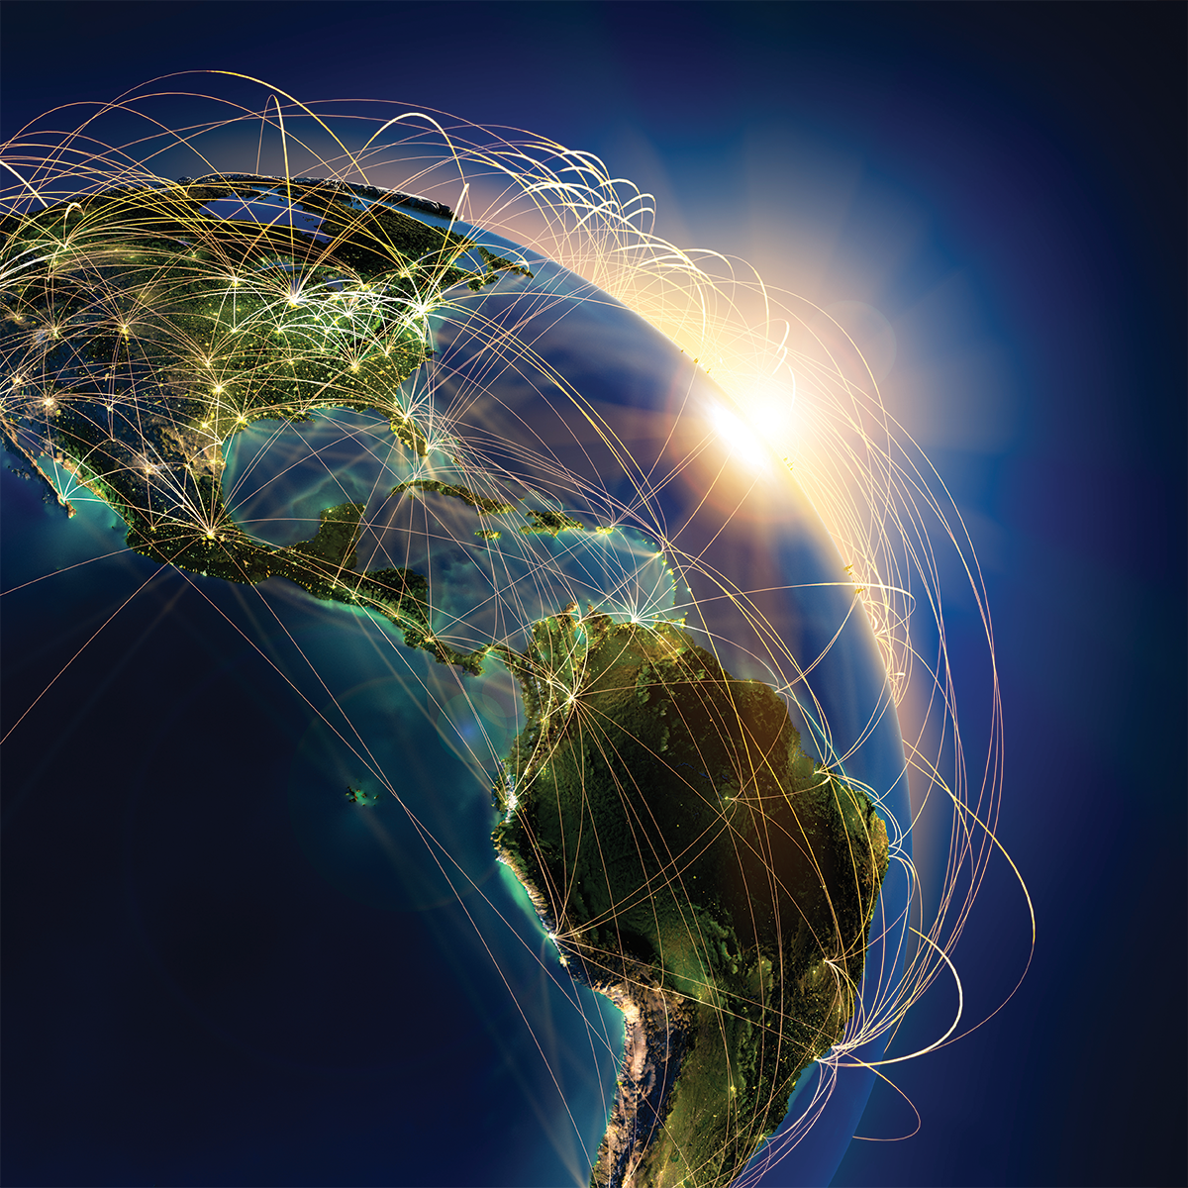
Towards a Latin American non-commercial Open Science ecosystem in the hands of academia: The articulation of the green and diamond routes
Dr. Arianna Becerril García

Slide 2
The discussion on Openness should go beyond how to achieve openness.
It should focus on how to achieve a global conversation of science. Then the the axis of the discussion moves to how to work towards equity, epistemic justice, bibliodiversity and inclusion. To accelerate the development of science

Slide 3
It is about rethinking, questioning, deconstructing / constructing ...
Principles and values in scientific communication
The industry of prestige
The role of current technologies
The role of each actor in the process of generation and communication of knowledge
The future of the academy

Slide 4
20 years after BOAI …
Increasing control of the knowledge production circuit by commercial publishers.
Restrictions on the rise: restrictions on where, when or how to deposit.
Publishing transition to digital technologies is both slow and disappointing
Damaging research assessment system (the industry of prestige)

Slide 5
Open access is not an end in itself, but a means to further ends. Above all, it is a means to the equity, quality, usability, and sustainability of research.
Our four high-level recommendations address systemic problems that obstruct progress toward these ends.
2022
1. Host OA research on open infrastructure
2. Reform research assessment and rewards to improve incentives.
3. Favor inclusive publishing and distribution channels that never exclude authors on economic grounds.
4. When we spend money to publish OA research, remember the goals to which OA is the means.

Slide 6
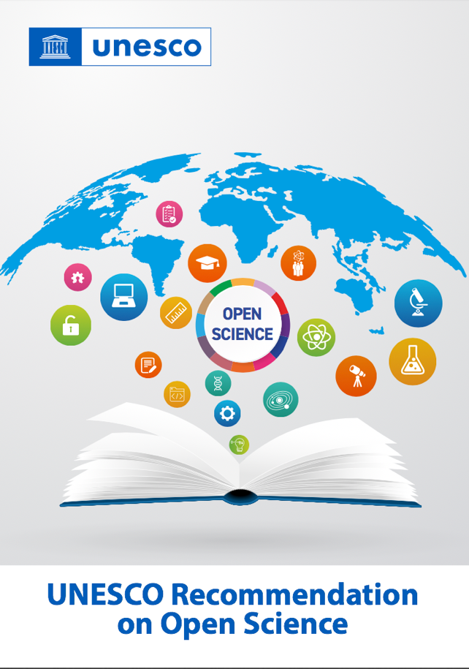
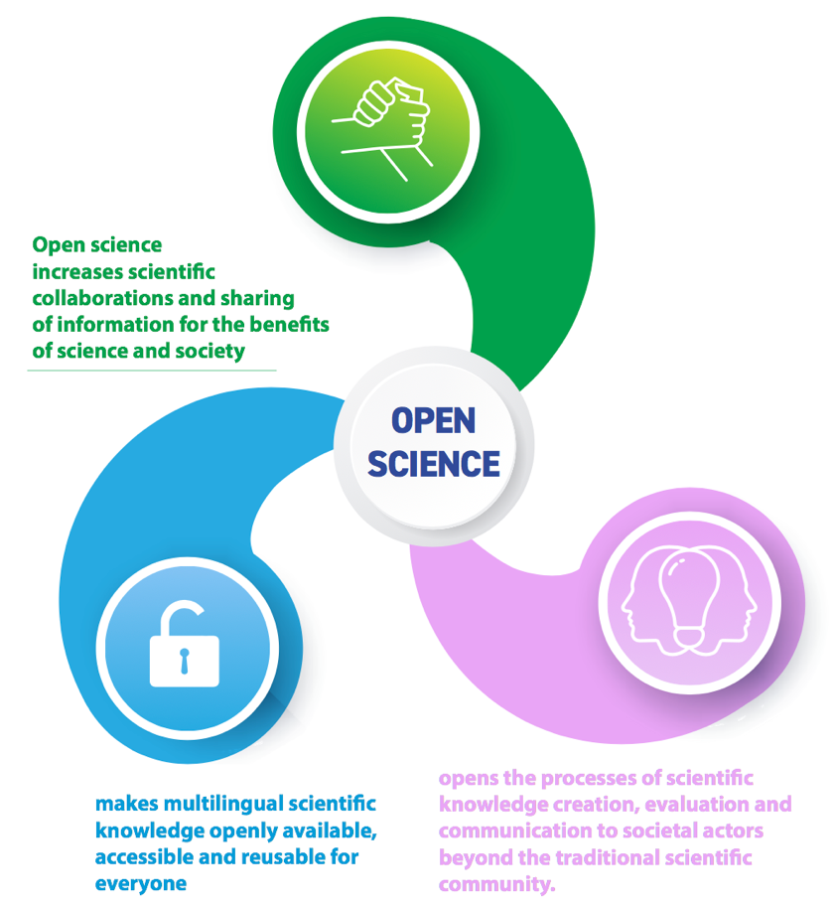

Slide 7
On what data is the industry of prestige founded?
Which regions, countries, science fields, journals, institutions or authors are privileged by current strategies? Which ones are excluded?
Which inequalities the current system will continue to perpetuate?
Is openness structural and sustainable?
Who owns and control the knowledge? The research community interests prevail?
The future restrictions on knowledge generation depend on the ownership.
How to achieve systematic participation in science (not patronizing strategies) that enables a global conversation?

Slide 8
Science as a global public good
Immediate Open Access
Non-profit
Green OA
Owned by academic institutions
Diamond OA
Bibliodiversity
Epistemic justice
Participation
Inclusion
Multilingüalism
Equity
Responsible assessment

Slide 9
Diamond OA towards science as a global public good
It prevents science publishing to be commodified
It allows the research community to own, control and lead scholarly communications
It doesn’t imply resistance to eliminate author rights retention
No current and future hidden restrictions (embargoes, deposit, data mining, text mining, etc)
It ensures long term OA
Full-text and data processability allows to advance technologies for knowledge discovery, optimization of editorial workflows, innovation for research assessment, linked data and open data

Slide 10
GREEN OA + DIAMOND OA COMPLEMENTARITY
Articles
published in
non-APC journals
Content
available in repositories
S C I E N C E C O M M O N S

Slide 11
Two regional reference approaches
THE FEDERATED NETWORK OF INSTITUTIONAL REPOSITORIES OF SCIENTIFIC PUBLICATIONS
OPEN INFRASTRUCTURE FOR ADVANCING DIAMOND OPEN ACCESS PUBLISHING
LA Referencia is a Latin American network of open access repositories.
It supports national Open Access strategies in Latin America through a platform with interoperability standards, sharing and giving visibility to the scientific production generated in institutions of higher education and scientific research.
> 12 countries form LA Referencia: Argentina, Brazil, Chile, Costa Rica, Colombia, Ecuador, El Salvador, Spain, Mexico, Panama, Peru and Uruguay.
Open Access journal index and article-hosting platform for Diamond OA publishing. It begun in 2002.
Includes journal quality assessment processes, full-text articles' hosting, automatic editorial workflow technology, metrics, and author-level services.
1,460 Open Access peer-reviewed journals published by 706 institutions from 31 countries
>750,000 full-text articles in several different languages authored by 1.8 million authors from 150 countries.

Slide 12
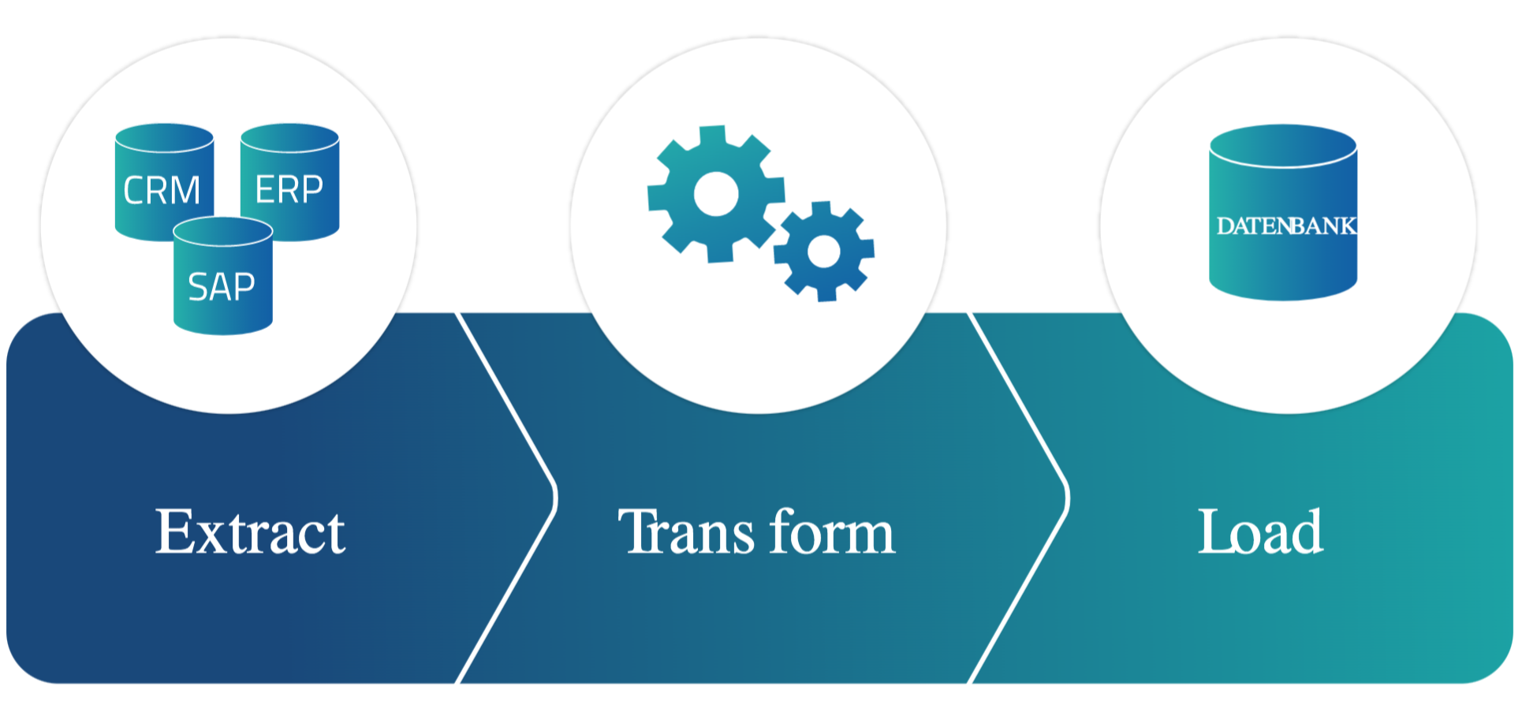
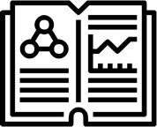
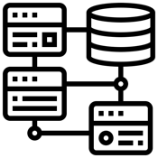
DATA PROCESSING AT REDALYC
The normalization and quality assurance of the data has been carried out by more than 30 people for almost two decades.
Redalyc have developed in-house programs to assist in the following processes.
Journal selection
Quality control
Data extraction
Data normalization
Author affiliations
Countries
Journals
Disciplines
Dates
Language
Data relational integration
Unique keys
Functional dependencies
Redundancy
Logical store

Slide 13
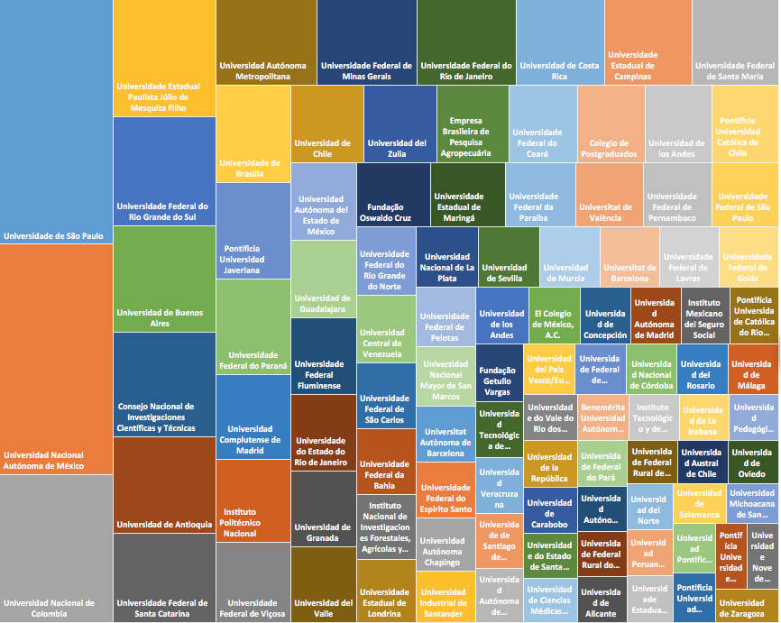
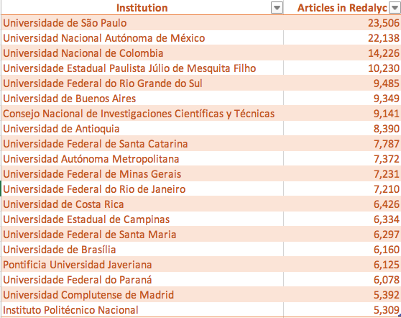
Scientific output published in Diamond OA journals indexed by Redalyc
50.271 institutions with articles in Redalyc
Top 20 institutions

Slide 14
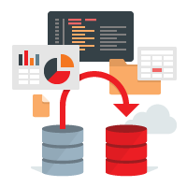
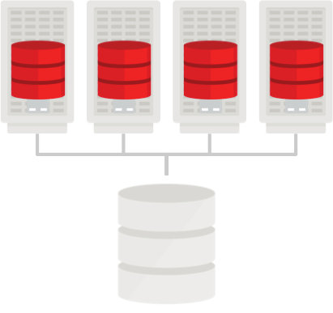
From a construction of a database system for Diamond OA journal articles … to a deconstruction of data fragments by institutions and countries

Slide 15
Diamond OA journal articles data from Redalyc to repositories
Institutional repositories
OAI-PMH data provider (base URL)
per institution
(more than 10 thousand data providers)
National repositories
OAI-PMH data provider (base URL)
per country node
Networks of repositories
The Redalyc data, at institutional and country levels, is openly available
Aggregators

Slide 16
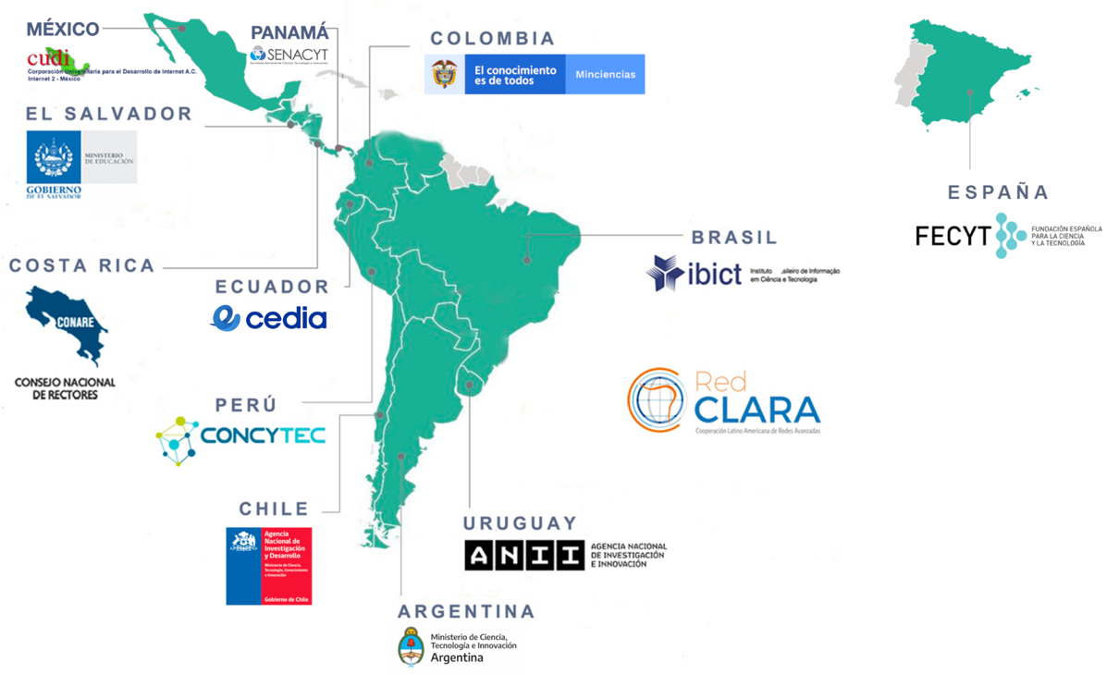
Diamond OA journal articles data from Redalyc to repositories
OAI-PMH data provider (base URL)
per institution
(more than 10 thousand data providers)
OAI-PMH data provider (base URL)
per country node
The Redalyc data, at institutional and country levels, is openly available

Slide 17
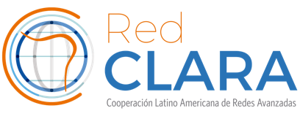
Framework of collaboration for the consolidation of a Regional Open Science Ecosystem
with the aim of generating regional public goods
Diamond Open Access content available in Institutional Repositories, in national nodes and in LA Referencia, as well as in evaluation systems and CRIS platforms.
Interoperability of the green and diamond routes that will improve visibility and contribute to new forms of scientific evaluation.
Spaces for discussion and exchange with other initiatives to contribute to the design of new metrics and mechanisms for the evaluation of research based on the inputs, outputs and Open Science processes.
Development of open software that improves the quality of metadata, compliance with international guidelines, preservation and retrieval

Slide 18
Thank you
Arianna Becerril García
arianna.becerril@redalyc.org
http://www.redalyc.org/autor.oa?id=25
http://orcid.org/0000-0003-0278-8295
@ariannabec

